Slide 1
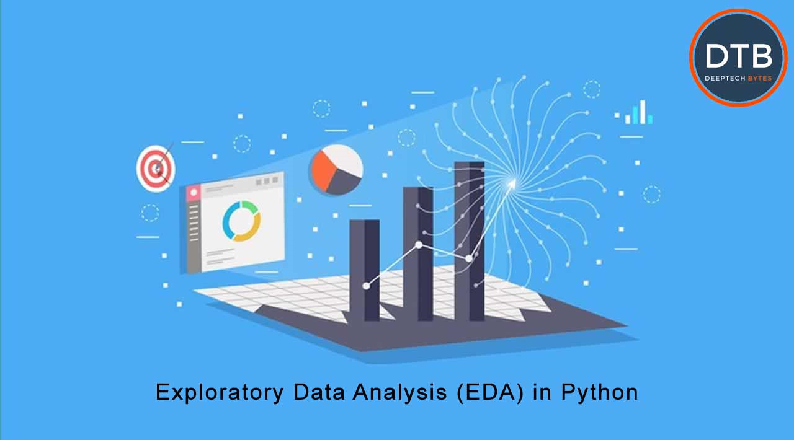
PROJECT 3: Exploratory Data Analysis (EDA) for Real Estate Pricing: Unveiling the Dynamics of House Valuation in a Dynamic Market
-ANIKET PATIL
DIGICROME ACADEMY

Slide 2

To identify and understand the myriad variables that significantly influence house prices. By leveraging advanced data analytics techniques and visualization tools, your goal is to uncover patterns, correlations, and trends within the dataset, enabling the company to make informed decisions and strategically position properties for better business opportunities
PROBLEM STATEMENT:

Slide 3

To Collect and Clean the data
Checking the Statical Condition
To handle missing data and improve the accuracy of the model
To perform exploratory data analysis (EDA)
To present the findings and insights from the project in a clear and concise manner.
OBJECTIVES

Slide 4



Importing Libraries: To perform Data Manipulation, Visualization, Model Building
Loading Dataset: Load the dataset
Basic Understanding of Data: basic information about the data
FLOW CHART
Data Preprocessing: Cleaning the dataset
Exploratory Data Analysis: To identify the data by graphical representation

Slide 5
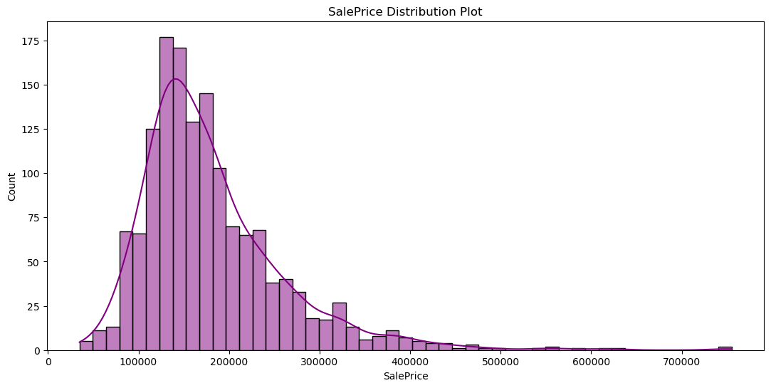


SalePrice Distribution Plot
REPORT ON EDA (INCLUDE PICTURES OF THE GRAPHS)

Slide 6
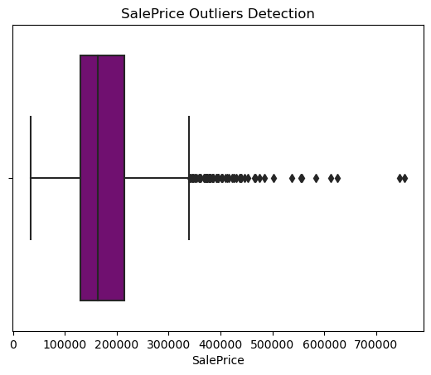
SALEPRICE OUTLIERS DETECTION

Slide 7
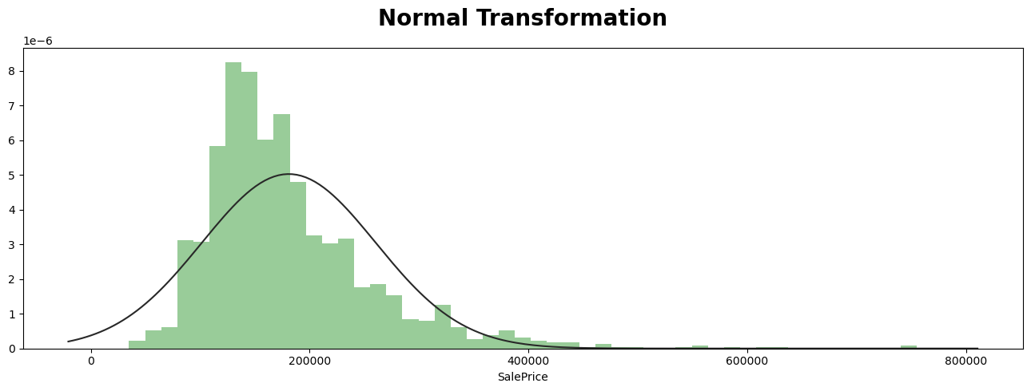
NORMAL TRANSFORMATION

Slide 8
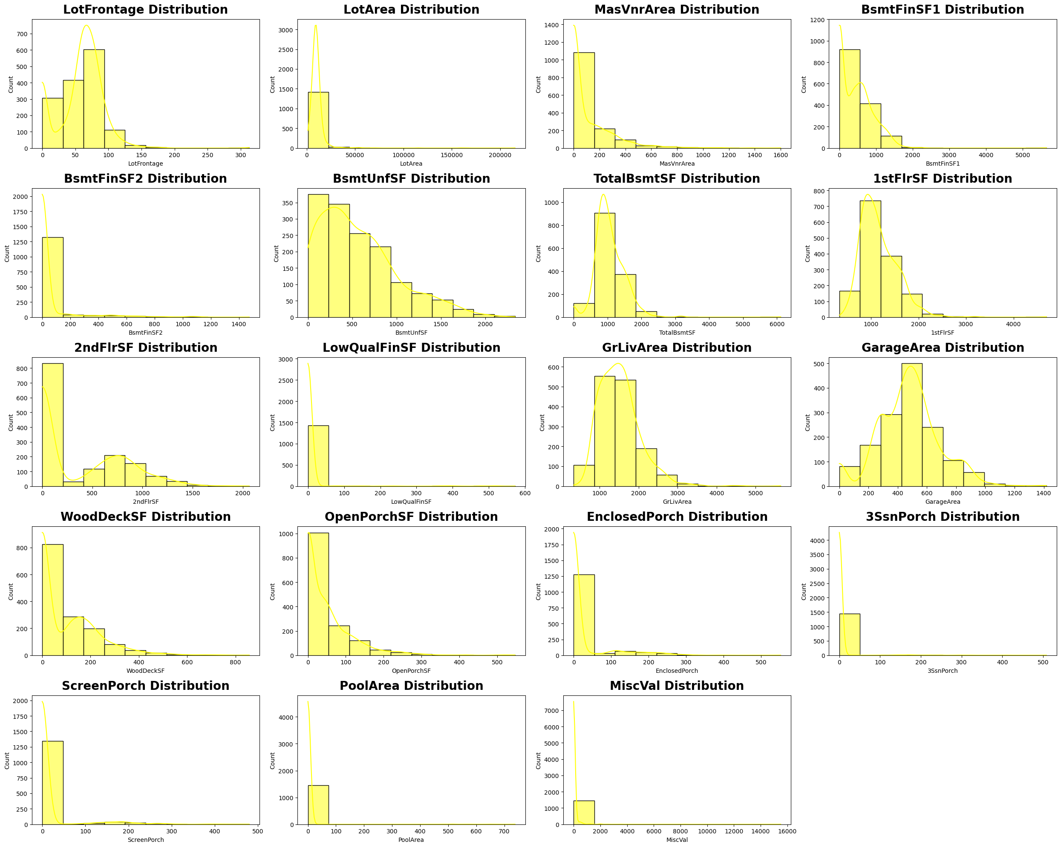
UNIVARIATE ANALYSIS

Slide 9
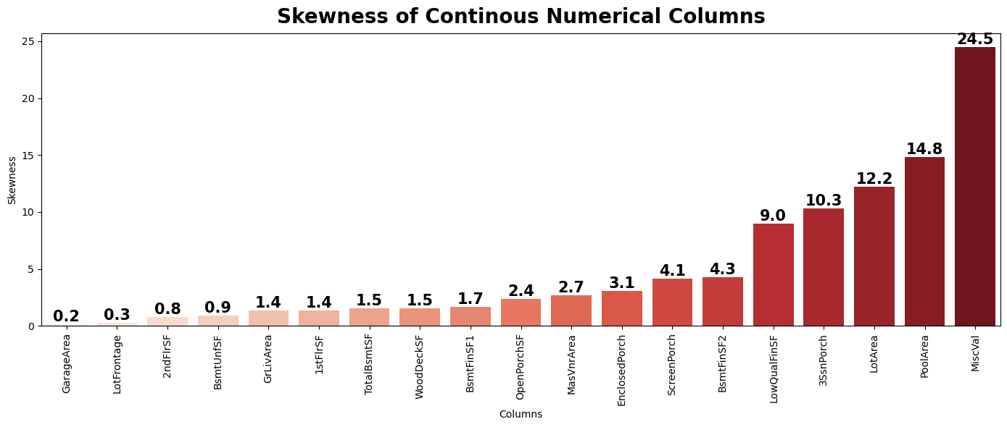
SKEWNESS OF CONTINOUS NUMERICAL COLUMNS

Slide 10
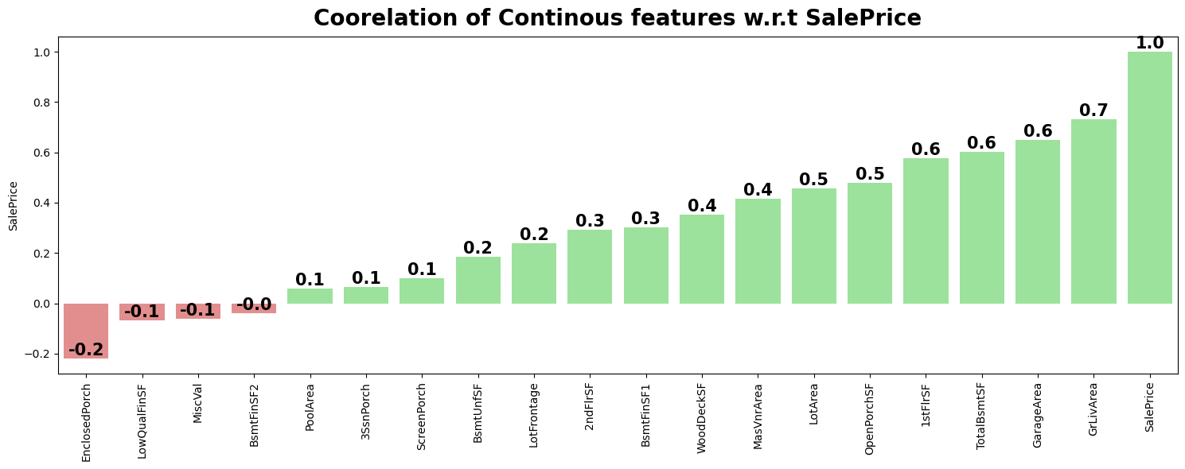
CORRELATION OF CONTINOUS NUMERICAL FEATURES

Slide 11
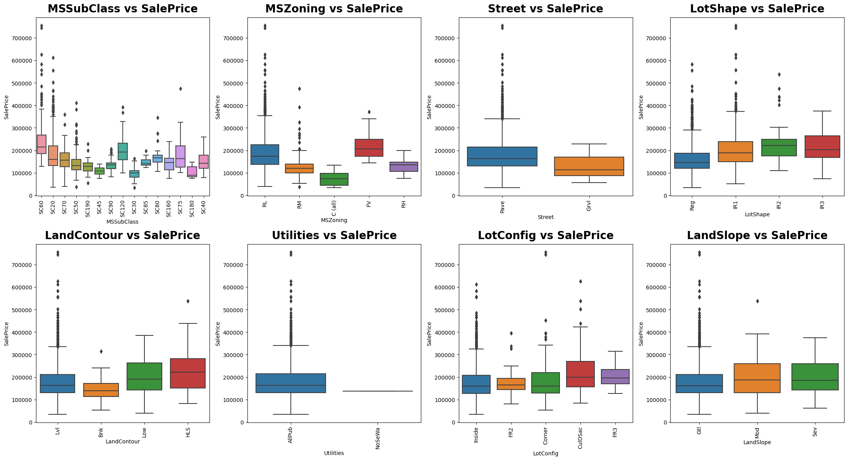
VISUALIZING CATEGORICAL FEATURES W.R.T SALEPRICE.

Slide 12
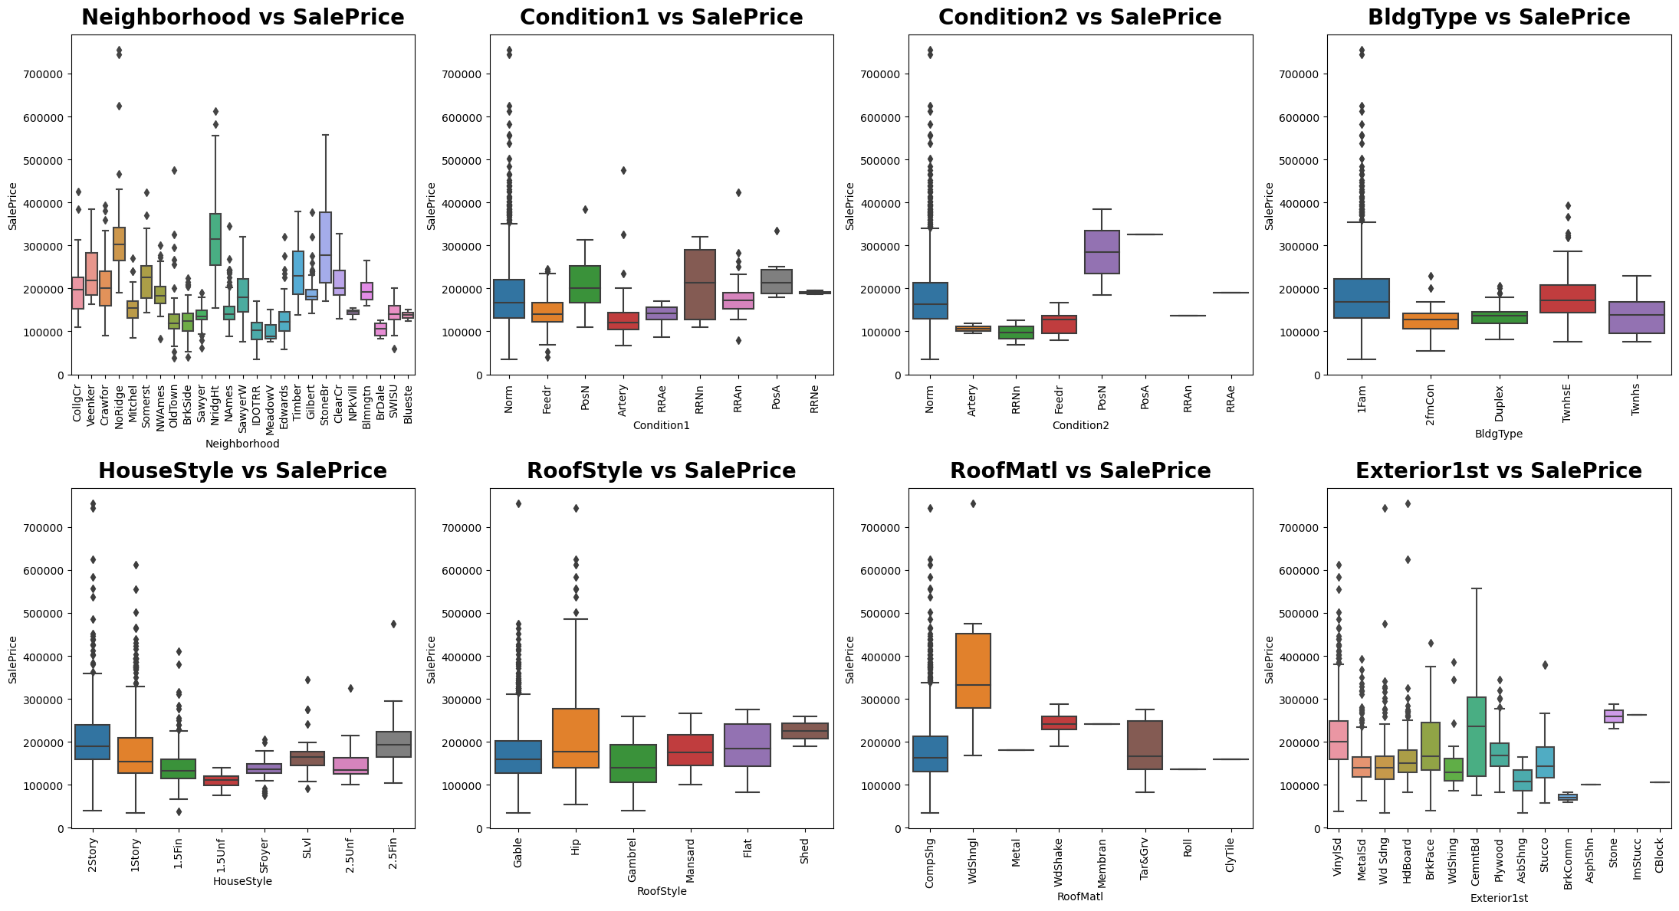

Slide 13
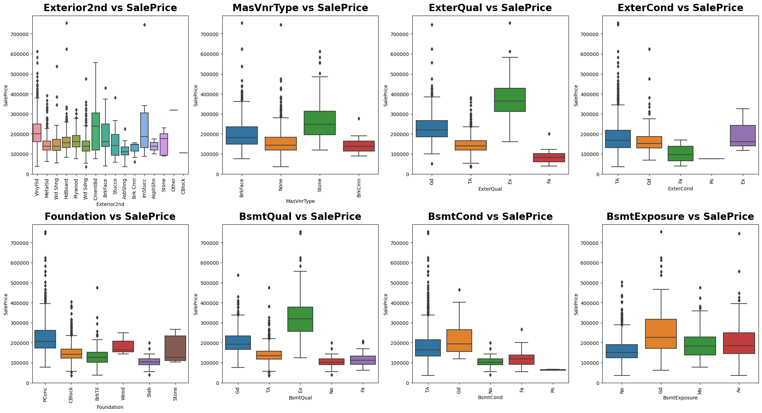

Slide 14
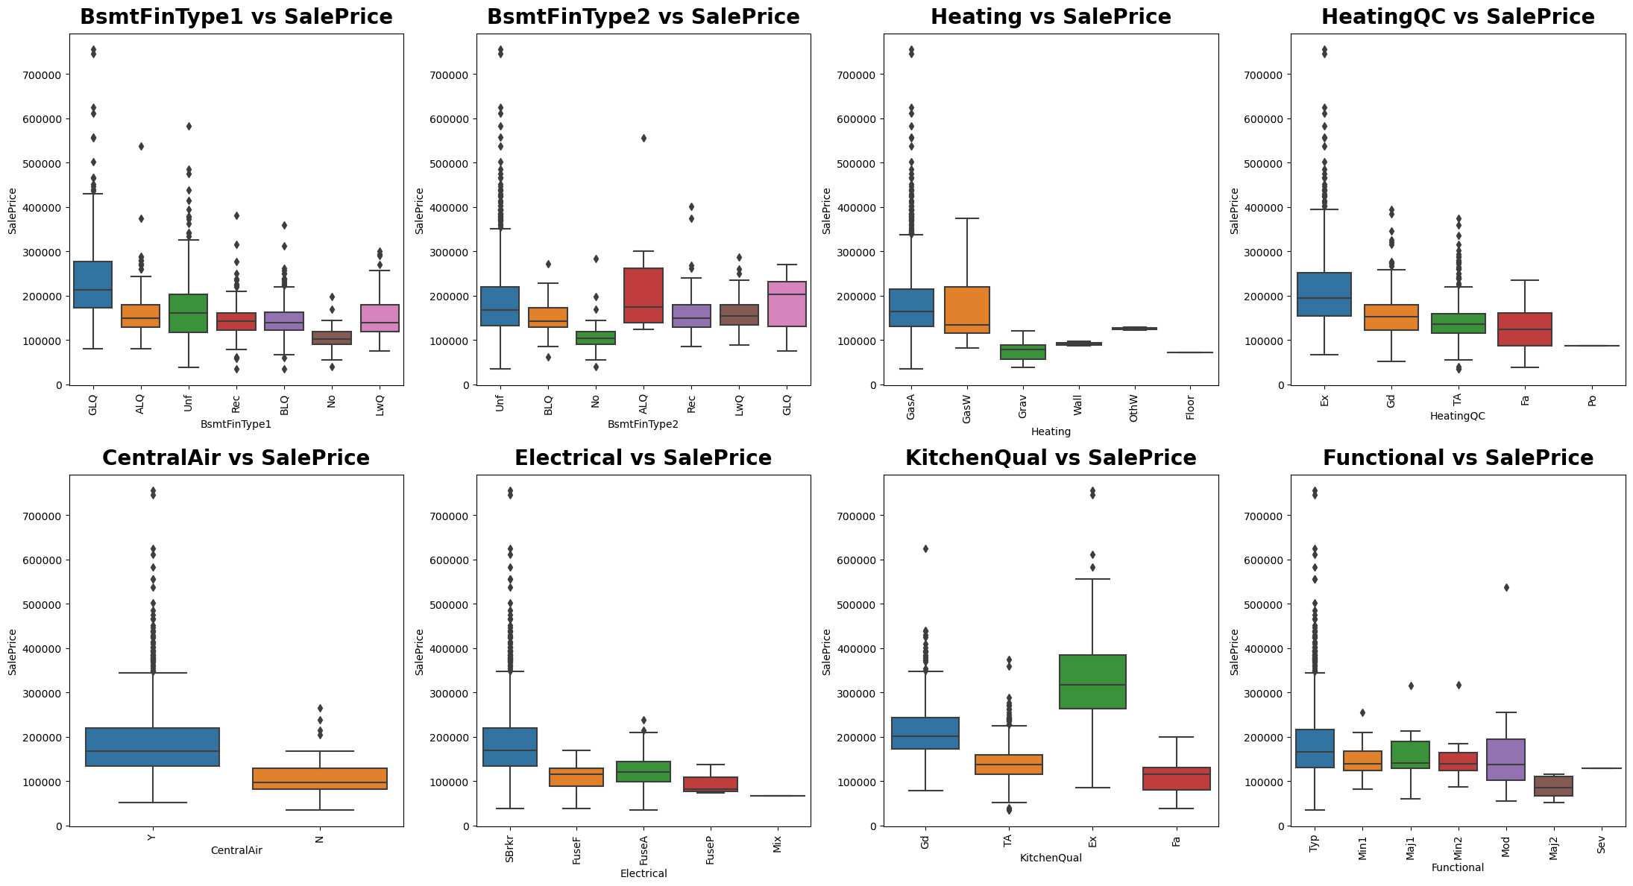

Slide 15
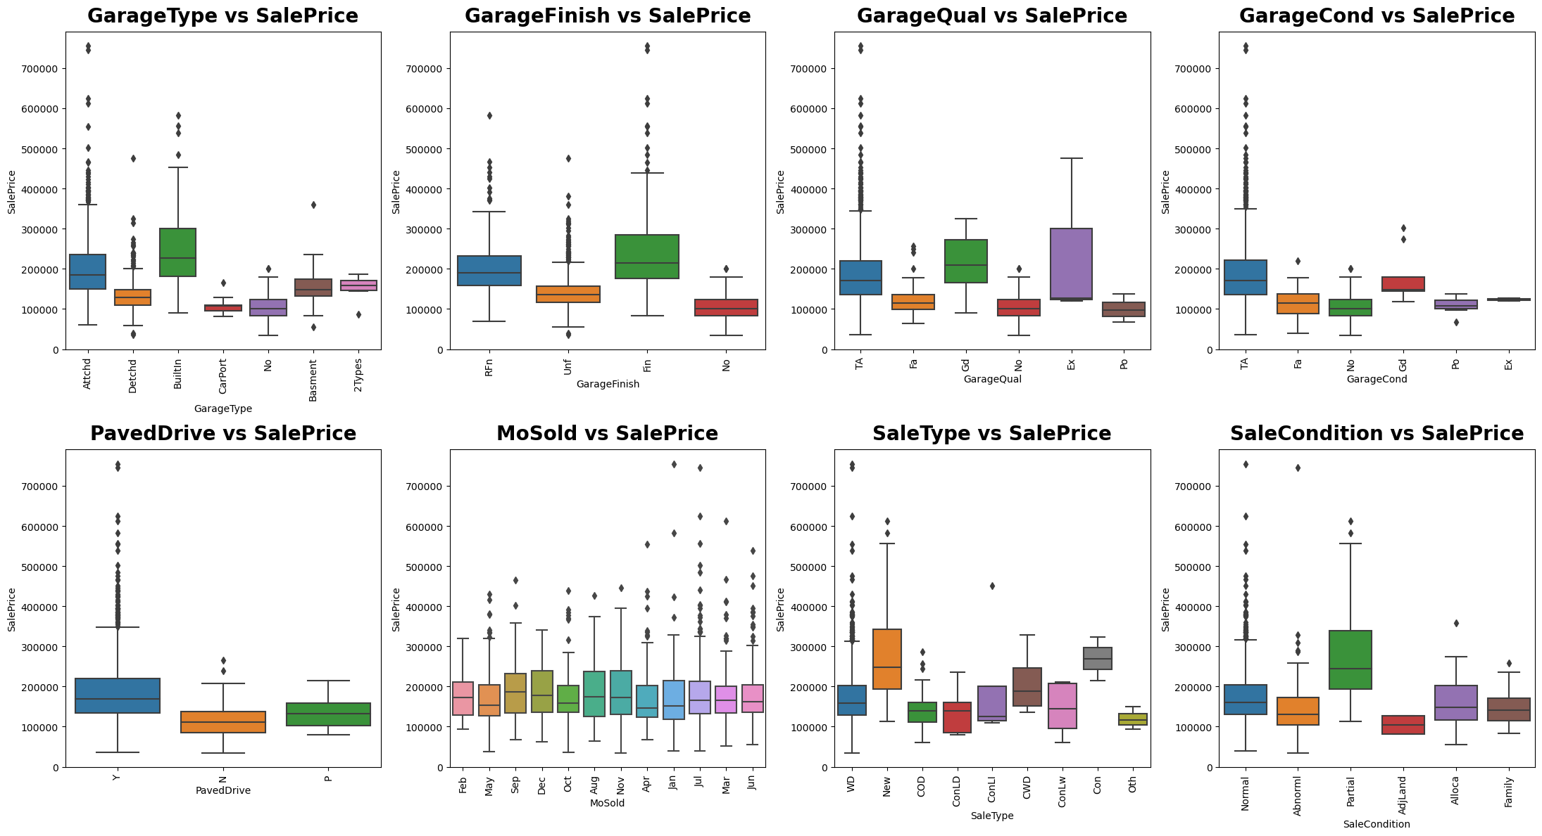

Slide 16
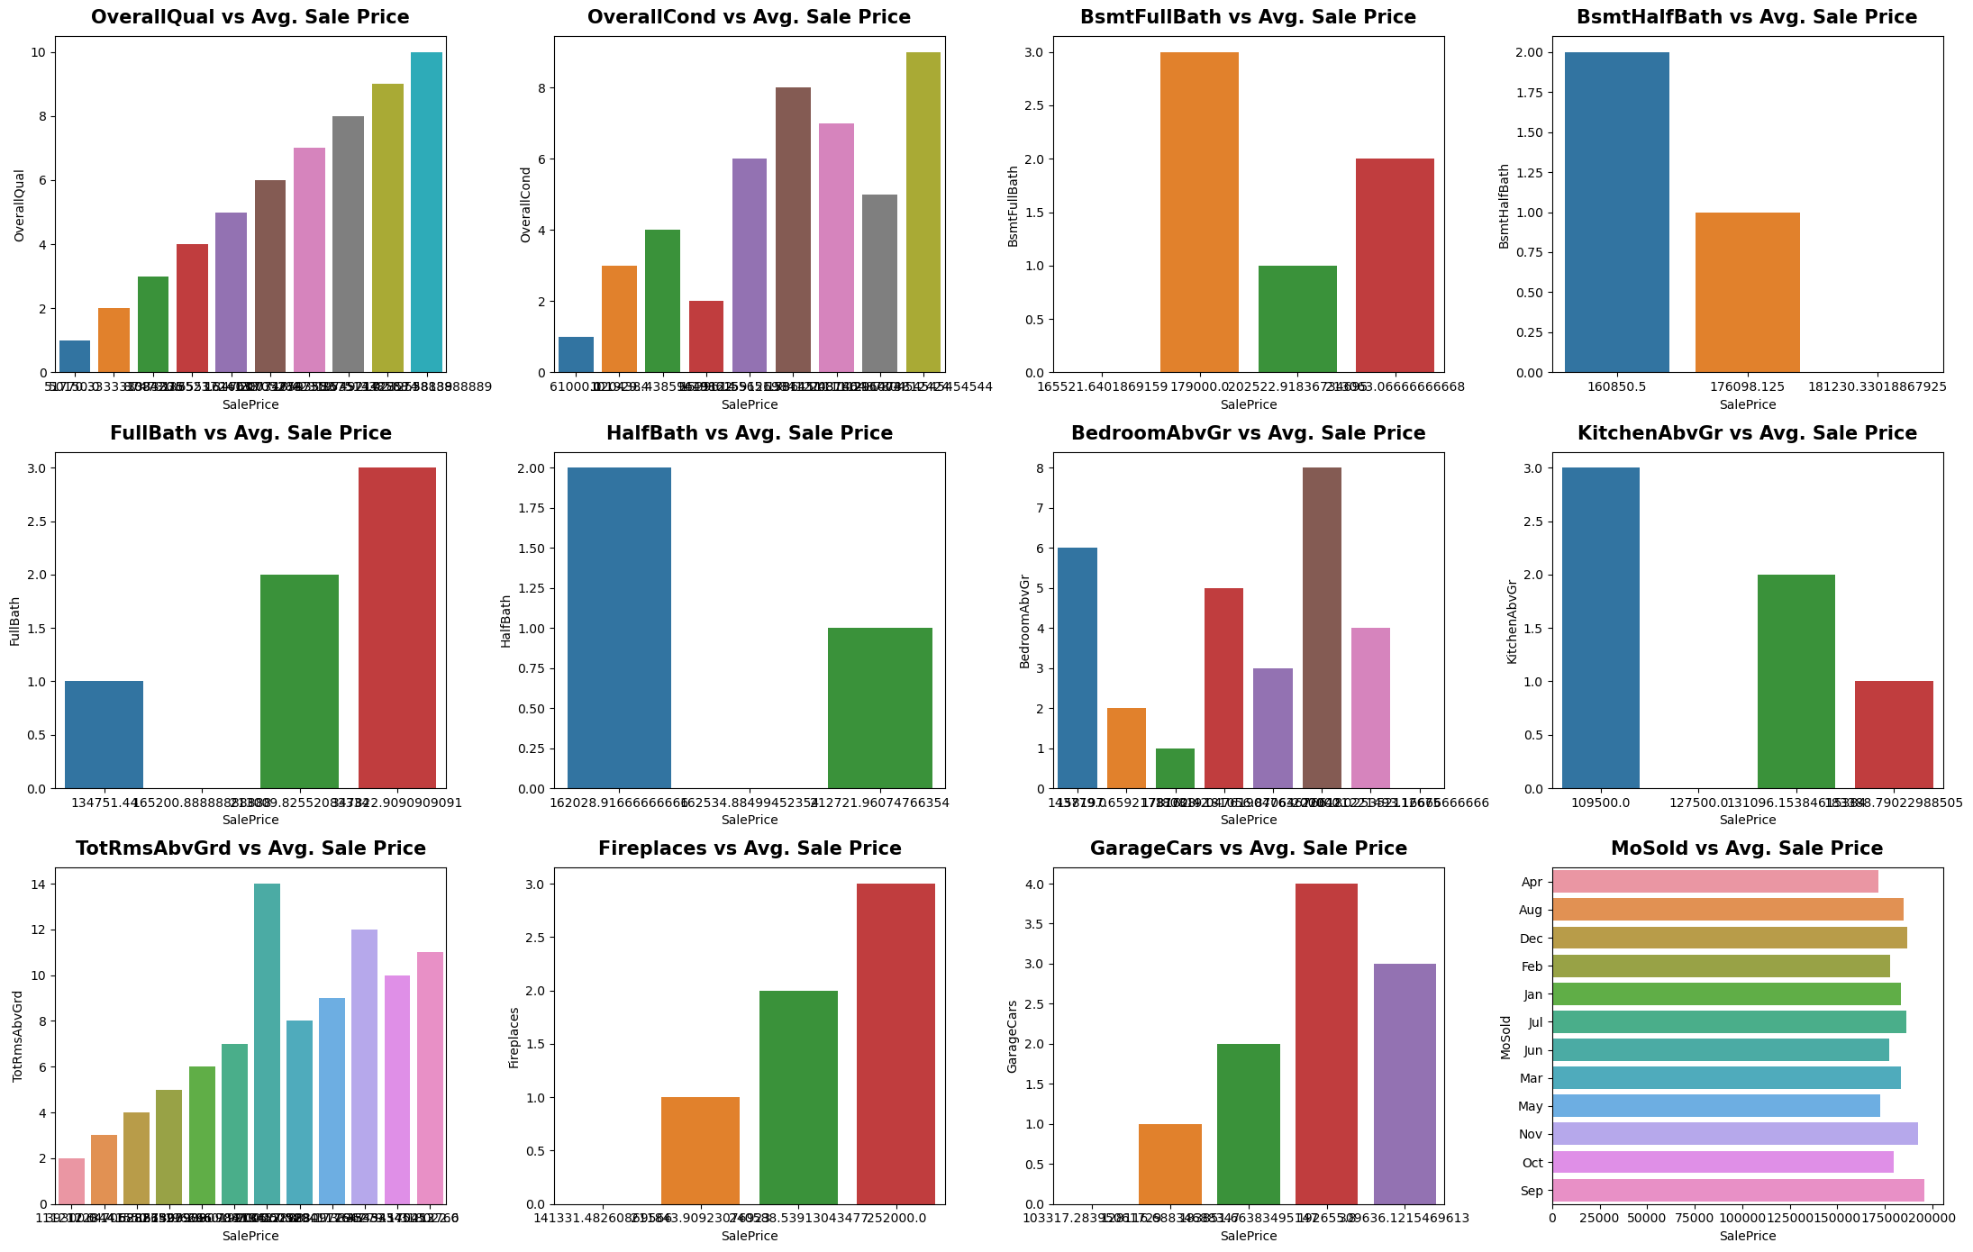
VISUALIZING DISCRETE NUMERICAL FEATURES W.R.T AVERAGE "SALEPRICE"

Slide 17

Insights into the significant features that influence property prices in the specific location.
A comprehensive report detailing the methodology, results, and insights from the project.
Through EDA, we can identify key variables that significantly impact house prices, allowing us to tailor pricing strategies, enhance customer satisfaction, and gain a competitive edge in the market. Moreover, EDA helps us uncover hidden relationships, outliers, and trends that may be obscured at first glance, ensuring a comprehensive analysis that goes beyond surface-level observations
LEARNING OUTCOMES

Slide 18

The project will involve collecting and cleaning data, performing EDA. The final outcome will be a comprehensive report detailing the methodology, results, and insights from the project
CONCLUSION

